Slide 1

Comparing Analysis Method Implementations in Software (CAMIS)
Lyn Taylor
June 2023
Notes:
Thank you for joining this session which will give an introduction to the PHUSE / PSI / R Consortium collaboration project “CAMIS”.
The QR code on screen will take you to the website for more information and I’ll put it up again at the end of the presentation.

Slide 2
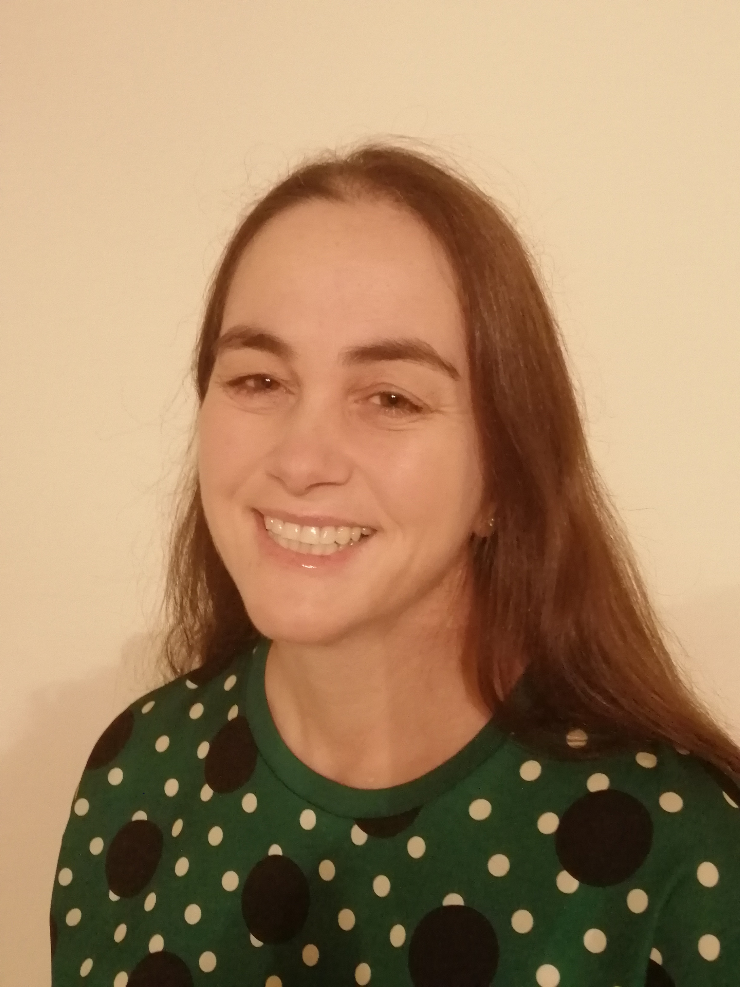
Lyn
Born in the 70’s
Learnt minitab, GLIM, MATLAB, SAS, SPSS, statistica and S-PLUS at university
20 years later SAS programming at a CRO
Heard of R – but lack of validation scares her
Fun Fact
Thinks “github” is a coffee shop
Notes:
Let’s jump straight into the life of a statistician by using a case study example !
This is Lyn. Lyn was born in the 70s and learnt minitab, GLIM, Matlab, SAS, SPSS, statistica and S-PLUS software at university.
She’s been working in the pharmaceutical industry doing statistical analysis in SAS for over 20 years.
She’s heard about R, but never found need to use it at her workplace. The lack of validation of the packages scares her !
When asked about github, she wondered if it was the coffee shop hub meeting that the “Group Information Technology” team go to?

Slide 3
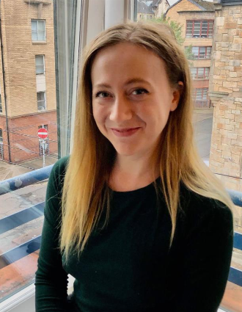
Molly
Born in the 90’s
Learnt R, python, matlab and SPSS at university
Graduated 2022 and started a job at a Contract Research Organization (CRO)
Fun Fact
Thought SAS was her Student Awards Agency Scotland (SAAS)
MOLLY PICTURE
Notes:
This is Molly.
Molly was born in 1990’s, she learnt R primarily at university with matlab, SPSS and a bit of Python
She graduated in 2022, and started a new job at a CRO and was keen to get analyzing data in the real world.
When asked about SAS, she thought it was the Student Awards Agency Scotland – who provide financial student loans to students in scotland.

Slide 4
Project 12345 – Year 2022
Kaplan-Meier plots of Overall Survival will be presented by treatment group.
Overall survival will be analyzed using a stratified log-rank test with hazard ratio and 95% CI from the cox-proportional hazards model
Client is software agnostic but needs the analysis today !
Molly and Lyn are assigned to do the Production and independent QC
Molly decides to use R
Lyn decides to use SAS
Notes:
The year is 2022:
A project gets assigned to Molly & Lyn to program and QC independently.
It’s a really simple analysis of Overall survival using Kaplan meier estimates, cox proportional hazards modelling and a log-rank test.
Kaplan-Meier plots of Overall Survival will be presented by treatment group.
Overall survival will be analyzed using a stratified log-rank test with hazard ratio and 95% CI from the cox-proportional hazards model
Client is software agnostic but needs the analysis today !
Lyn’s done these 1000’s of times before in SAS, expects to be home on time tonight.
Molly’s never done this in SAS before, but has used R on her university course, so decides it will be quicker for her to use R to do the work.

Slide 5
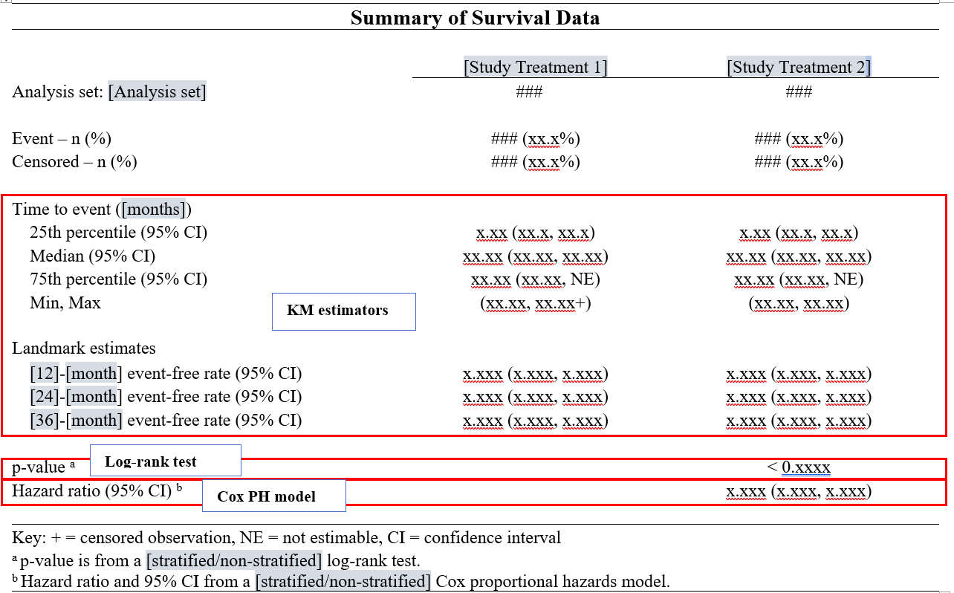
Project 12345 – Shell required
With Thanks to Mia Qi & Min-Hua Jen
Notes:
Here is the shell they’ve been provided with.

Slide 6
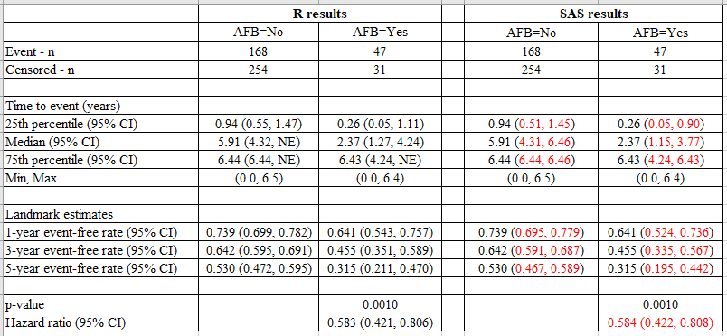
Project 12345 – R vs SAS Results
Table produced with Thanks to Mia Qi (JnJ) & Min-Hua Jen (Eli Lilly)
Notes:
Molly and Lyn output a dataset containing the results, but some do not agree?
They compare input datasets – which are identical so the discrepancy must be because R & SAS are doing something differently?
But
Which is correct?
Who needs to change their code & how?
What do they do now?

Slide 7


Project 12345 – Year 2022 Panic !!
Panic attack Symptoms (lifestylealigner1-panicattacksymptoms.blogspot.com)
Notes:
In the year 2022… this may lead to a Panic and a lot of stress.
Considerable investigation of the documentation supporting the R package Molly is using would be needed. This would then need comparing to the SAS manuals/website to try to determine why the differences exist.
It could lead to missing the deadline required by the client.

Slide 8


Project 12345 – Year 2023
Notes:
However, lets fast forward to 2023 !!
Molly and Lyn Access the CAMIS website.
They consult the CAMIS repository Survival analysis pages, they find the problem is already documented there and hence know what to do to fix the discrepancy.
The issue is resolved & they both leave work early, having delivered a high quality package to the client.
So What is CAMIS – and what can you do to help ?

Slide 9
Welcome to the CAMIS repository !
CAMIS: Comparing Analysis Method Implementations in Software
A cross-industry collaboration formed of members statistical and programming associations such as PHUSE, PSI, IASCT and ASA.
Aims:
To create a white paper
To create a github repository to store how to apply statistical methods in various software and document any differences observed in the results obtained
Notes:
CAMIS stands for: Comparing Analysis Method Implementations in Software
This is a cross-industry collaboration formed of members statistical and programming associations such as PHUSE, PSI, IASCT and ASA. Anyone can be a contributor.
We have 2 Aims:
1) To create a white paper
2) To create a github repository to store how to apply statistical methods in various software and document any differences observed in the results obtained

Slide 10
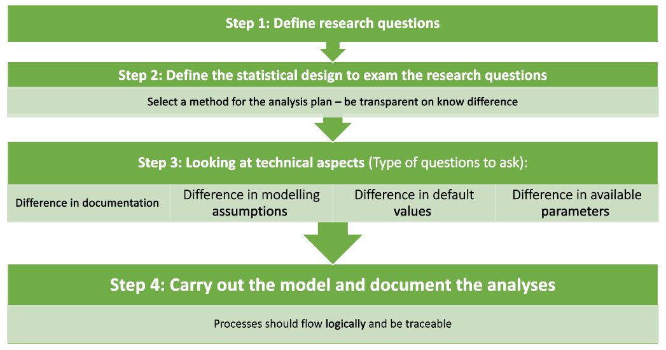
CAMIS White Paper
Notes:
The white paper describes a 4 point process to ensure analysis is clearly specified such that it isn’t reliant on software default settings which can change across software
Define the research question – often in the protocol
Define the statistical design to examine the research questions. Select a method for the analysis plan and be transparent on any known differences which approach you are taking
Look at the technical aspects a) differences in software documentation for which methods are being used (convergence algorithms etc), 2) any modelling assumption differences, 3)any default values used by software? 4) any differences in the available parameters.
Carry out the pre-specified analysis and display the results.

Slide 11
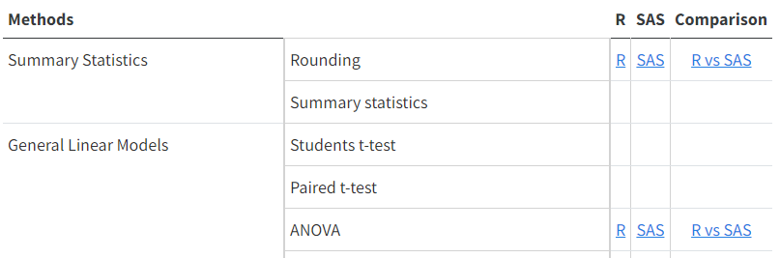
The CAMIS repository
https://psiaims.github.io/CAMIS/
For each Method currently completed the repository contains
Application in R
Application in SAS
Comparison between software results / noting differences
We hope to expand to include Python, Julia and/or other software
Notes:
The repository is now LIVE and we are building up examples of the methods applied in R, SAS and documenting any differences between how the software performs the statistical method.
NOTE: we hope to expand to include Python, Julia & other software in the future.
When you get to the CAMIS home page, you will see a Table of methods. If a link exists then we have already created documentation for that method.
If no link exists and you have content you would like to add then please get in touch with us.

Slide 12
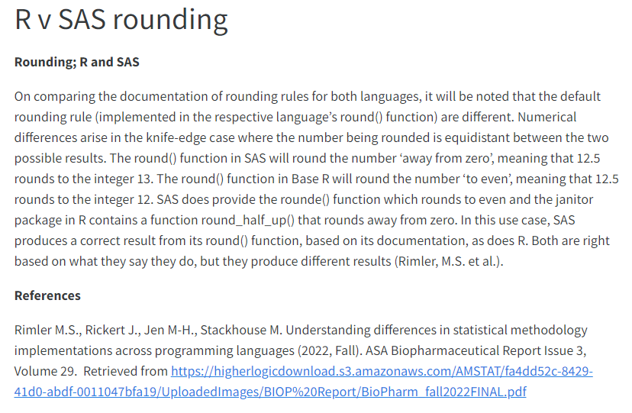
The CAMIS repository - Rounding
Number to round | Round() in R, or rounde() in sas | Round() in SAS or janitor package [round_half_up() in R]
1.2345 | 1.234 | 1.235
Notes:
For example….lets take the simple case of rounding…
The round() function in Base R will round to the nearest whole number and ‘rounding to the even number’ when equidistant, meaning that exactly 12.5 rounds to the integer 12.
This can be replicated in SAS using the rounde() option is SAS, but the more standard/default option in SAS is to use round()
The round() function in SAS will round to the nearest whole number and ‘away from zero’ or ‘rounding up’ when equidistant meaning that exactly 12.5 rounds to the integer 13.
The table shows where this rounding difference between SAS & R could be the source of obtaining different results.
Both SAS and R can have their defaults change to produce the same results.

Slide 13



Call for Action – How you can help?
Documenting how to perform statistical methods in R, SAS & comparing them
Adding issues to the repository of differences found between R & SAS
You can be a contributor or JOIN US on the PHUSE working group
Adding content for Python, Julia or other software
Review/ revision of existing CAMIS content.
Notes:
This presentation is a call for Action - so here is how you can help us to build a high quality comprehensive repository.
Would you be interested in documenting how to perform a statistical method in R, SAS and comparing them? Our github repo has a list of issues awaiting investigation. If you would like to contribute to a specific are then please get in touch to be assigned.
Do you already have some content that you would like to load to the site which documents some difference between the was SAS and R do statistical analysis. If so please get in touch and we can show you how to load to the site
Do you want to explore other software?
Are you a statistical expert and would like to review our content to ensure our methods and documented correctly. Then please review our existing CAMIS content and do a pull request to suggest changes/ corrections.
This is a community led effort so the more people we have contributing the more comprehensive the project can become.
You can be a contributor or join the PHUSE working group which meets monthly.

Slide 14
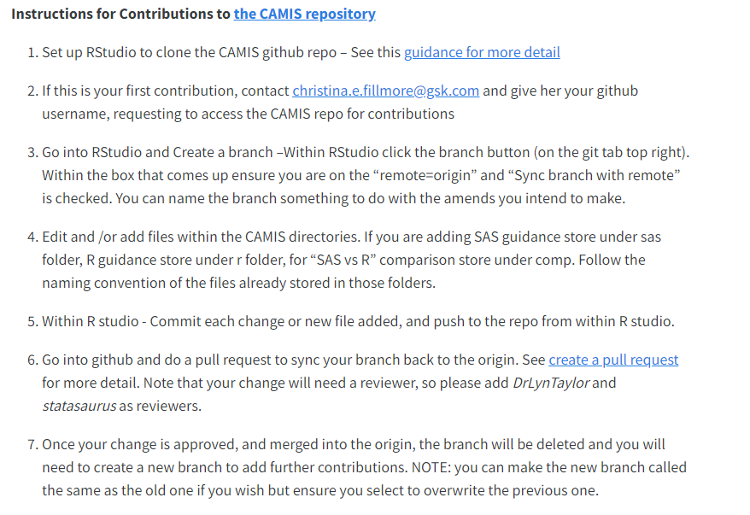
How to Contribute?
Go to the Contribution tab on the website and follow these instructions
Notes:
For instructions of how to contribute please go to the contribute Tab on the website where step-by-step instructions exist.

Slide 15

How to contact us?
psi.aims.r.validation@gmail.com
https://github.com/PSIAIMS/CAMIS/discussions
Notes:
For more information please check the website. For specific questions you can reach out to us at psi.aims.r.validation@gmail.com or at the github discussions tab: https://github.com/PSIAIMS/CAMIS/discussions

Slide 16
Thank you

